Slide 1

Symbiosis Institute of Geoinformatics
XAI Driven Crop Health Assessment using UAV Imagery
Siddhi Jadhav
23070243047

Slide 2
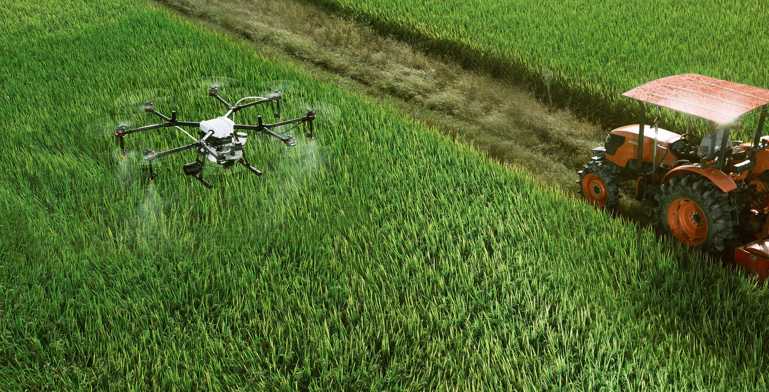

XAI Driven Crop Health Assessment Using UAV Imagery

Slide 3
agenda
Introduction
Dataset
Tools
Methodology
Preprocessing
CNN
Pretrained Models
Explainable AI
Results

Slide 4
INTRODUCTION
Agriculture is the backbone of many economies, playing a key part in ensuring food security.
Plant diseases pose serious risks to crop quality and production, resulting in large financial losses and food shortages
The Plant Village Dataset is restricted to controlled environments and close-up photos, which do not adapt well to real-world situations.
Therefore there is a need to move beyond this controlled environment and work on real environment that is Field captured dataset which is captured using Drones(UAV Images).

Slide 5
Analyzing 55 publications, they determined that to identify illnesses in leaves, 55% of the articles used a deep learning strategy, 25% a machine learning approach, and 20% statistical methods(Shahi et al., 2023)
Out of all papers, 58% used field based images, 28% used plant based images and 14% used leaf based images for processing. The most widely used CNN models are GoogleNet, VGG16, retinaNet. (Chin et al., 2023)

Slide 6
The remote sensing techniques employed for PA tasks can be grouped into three categories:
field-based sensors,
satellite or aircraft-based sensors
drone-based sensors
The field-based sensors have the limitation of acquiring field information at scale as they need to move from place to place, which adds extra labor and cost .
Furthermore, satellite- or aircraft-based spectral images are costly to acquire and may not be available as and when required .
Alternatively UAVs also known as drones, which have recently been introduced to PA, can fly very close to crops and provide very high spatial resolution field images

Slide 7
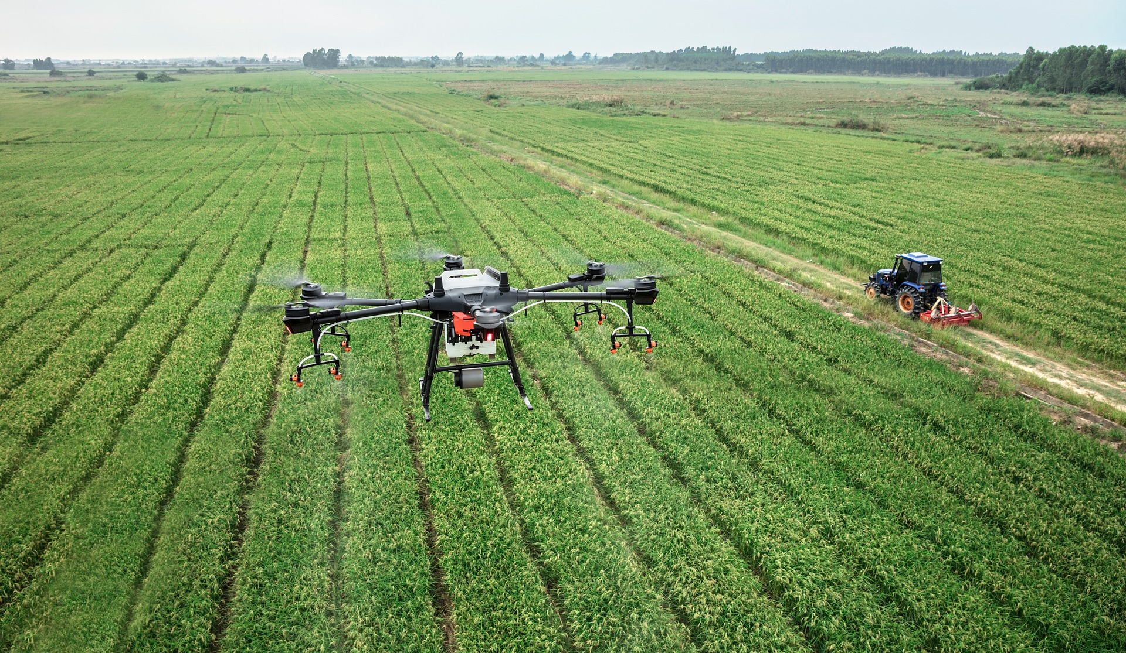
UAV IMAGES

Slide 8
WHY UAV IMAGES ?
permits early diagnosis, stops the spread of illnesses
drastically lowers crop loss.
UAV photos help to create more resilient and adaptable models.
Plant Village collection, while extensive, is restricted to controlled environments and up-close photos, which did not adapt well to real-world situations.
Also UAV-based remote sensing can record high-resolution imagery at close ranges.

Slide 9
RESEARCH OBJECTIVES
To Develop a “Convolutional Neural Network” Model to accurately classify leaves as healthy or diseased from UAV Image Dataset.
To Evaluate the performance of developed CNN Model.
To compare performance of developed model with pre-trained models.
To integrate model with Explainable Ai techniques (LIME) to understand which features of image are contributing in model’s prediction.
To Build a interactive Ui where one can upload image and get prediction.

Slide 10
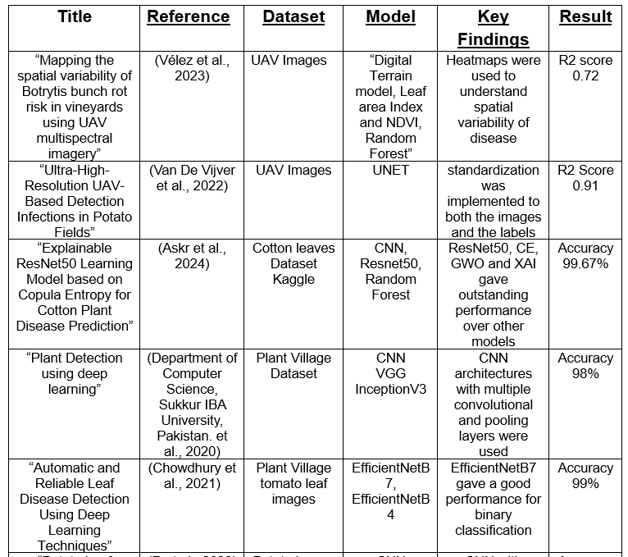

Slide 11
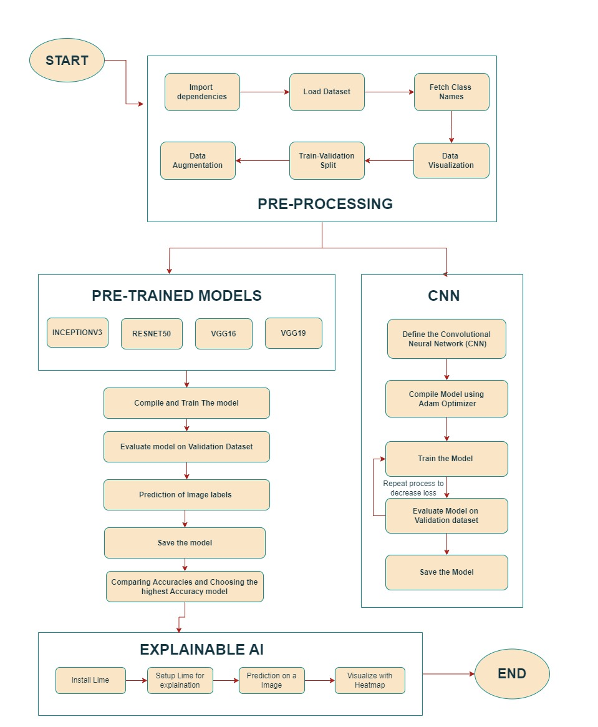
WORKFLOW DIAGRAM

Slide 12
TOOLS
Software :- KAGGLE , GPU T4
LIBARARIES :-
Python
TensorFlow/Keras
OpenCV
NumPy
Scikit-learn
Matplotlib
SHAP/LIME
Streamlit

Slide 13
METHODOLOGY
Used Kaggle to train and examine the model using the dataset
Load the Image Dataset
Import all the dependencies required
Visualizing Sample Images from the dataset
Apply data Augmentation to all Images
Assign 80% as training data and 20% as validation data
Build a CNN model and compile it
Train the CNN model
Save the Trained model having best Accuracy

Slide 14
Evaluate model on Validation Dataset
Prediction of Image Labels from Validation Dataset
Evaluating model using Evaluation Metrics
Build Pre-Trained Models (VGG16, VGG19, ResNet50, InceptionV3)
Using Training data, Train the Pre-trained models
Save the Trained model having best Accuracy
Evaluate model on Validation Dataset
Prediction of Image Labels from Validation Dataset
Evaluating model using Evaluation Metrics
Compare the accuracies of Pre-trained models and select the best model that is having the highest accuracy score.
Use XAI to explain the predictions of best model using LIME.

Slide 15
DATASET
Dataset Description
The dataset "Ultra high resolution modified RGB UAV-imaging of Alternaria solani" was collected from experimental fields in Belgium during the growing seasons of 2019 and 2022 using a DJI M600 PRO UAV with a modified Sony Alpha 7III camera. It includes labelled image patches (256x256 pixels), sorted into two categories: Alternaria (1) and no Alternaria (0).(Wieme et al., 2024)
Dataset source
This dataset is downloaded from Zenodo
Dataset link
https://zenodo.org/records/10727413

Slide 16
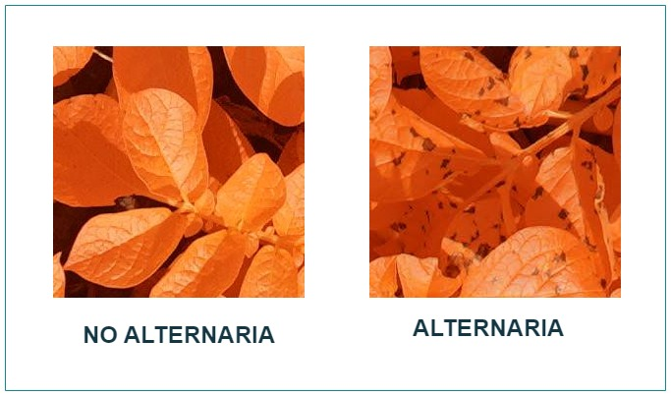
Images with labels
The left image is the image of a healthy leaf whereas right image is affected by Alternaria)

Slide 17
DATASIZE
The Dataset total consists of total 7143 Images. These images are separated across two categories (Alternaria Solani and No Alternaria Solani) and is used as the primary data for training and validating the dl model for “plant disease detection”
Category | Label | No. of images
Alternaria Solani | 1 | 3816
No Alternaria Solani | 0 | 3327

Slide 18
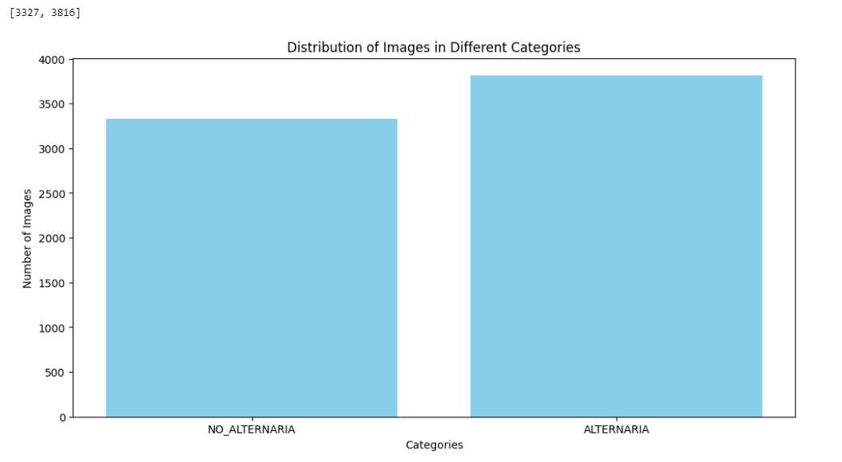

Slide 19
Images after train-validation split (80-20)
 | Train Set | Validation Set
Alternaria(1) | 3052 | 763
No Alternaria(0) | 2661 | 665
 | 5714 | 1429

Slide 20
CNN Architecture

Slide 21
CONVOLUTIONAL NEURAL NETWORK
The model is a “Convolutional Neural Network (CNN)” built for image classification tasks. It starts by processing input images of size 256x256 with three color channels (RGB). The network is composed of five convolutional blocks, each block designed to learn and enhance features from the images.
Each block includes a Conv2D layer with increasing order of filter size that is (32, 64, 64, 128, and 256), followed by BatchNormalization to stabilize and accelerate the training process. The Relu activation function is used after BatchNormalization. then AveragePooling2D reduces height and width of input feature maps, capturing the most important information while minimizing computational cost.

Slide 22
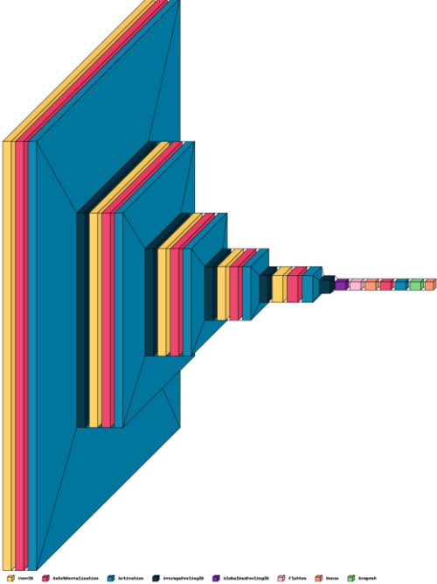
Input: 256x256x3 image.
5 Conv Blocks:
Each block has Conv2D (32 → 64 → 64 → 128 → 256 filters), Batch Normalization, ReLU, and Average Pooling.
Global Max Pooling: Reduces spatial dimensions.
Flatten: Converts 3D output to 1D.
Fully Connected Layer: Dense (256 units) + Batch Normalization + ReLU + Dropout.
Output Layer: Sigmoid activation for binary classification.

Slide 23
Parameters Configuration
Training And Validation Accuracy And Loss
EPOCHS | 30
STEPS | 179
VERBOSE | 1
BATCH_SIZE | 32
IMAGE_SIZE | (256,256)
CHANNELS | 3
Training_accuracy | 0.9995
Training_Loss | 0.0147
Validation_accuracy | 0.9304
Validation_loss | 0.2380

Slide 24
PRETRAINED MODELS

Slide 25
PRE-TRAINED MODELS
VGG16
VGG19
INCEPTIONV3
RESNET50

Slide 26
VGG16
Pre-trained VGG16 (without top layers).
Input size: 256x256x3.
Global average pooling layer.
Dense layer with 1 unit and sigmoid activation (for binary classification).

Slide 27
VGG19
VGG19 Base: Pre-trained on ImageNet top layers excluded.
Frozen Layers: All VGG19 layers are non-trainable.
Flatten Layer: 3D to 1D conversion.
Dense Layer: 128 units, ReLU activation.
Output Layer: 1 unit, sigmoid activation for binary classification

Slide 28
Inceptionv3
InceptionV3 Base: Pre-trained on ImageNet, top layers excluded.
Frozen Layers: All base model layers are non-trainable.
Flatten Layer: 3D to 1D conversion.
Dense Layer 1: 128 units, ReLU activation.
Dense Layer 2: 256 units, ReLU activation.
Output Layer: 3 units, softmax activation for multi-class classification.

Slide 29
RESNET50
ResNet50 Base: Pre-trained on ImageNet, top layers excluded.
Frozen Layers: All layers are set to non-trainable.
Flatten Layer: Converts 3D feature maps to 1D.
Dense Layer 1: 128 units, ReLU activation.
Dense Layer 2: 256 units, ReLU activation.
Output Layer: 1 unit, sigmoid activation for binary classification.

Slide 30
EXPLAINABLE AI

Slide 31
The goal of explainable AI (XAI) is to simplify AI systems for human Understanding. Suppose you had a robot that could decide for you, for example, if a picture shows a pen or a pencil. You should find out why the robot chose to say "this is a pencil" if that is what it says. Such decisions are explained by XAI.
To put it simply, XAI increases the transparency of AI systems by revealing the reasoning behind their decisions. It provides answers to queries such as:
How was this decided by the AI?
What elements did it take into account?
Can we rely on its choice?

Slide 32
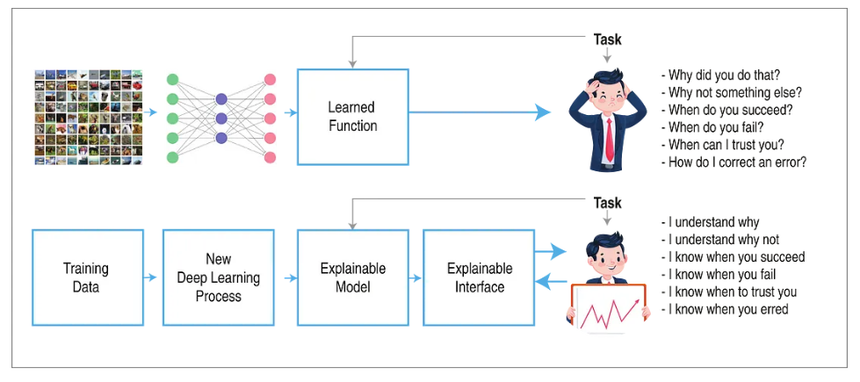
https://medium.com/deepviz/what-is-xai-explainable-ai-and-visualization-part-10-da41c981c5fa

Slide 33
Local Interpretable Model-agnostic Explanations (LIME)
LIME is a technique that provide understandable explanations for individual predictions, particularly valuable in “deep neural networks”.
The “LimeImageExplainer” is used to explain how deep learning models make predictions on image data. It helps in explaining and understanding model behavior, showing which parts of an image are most relevant to the model when it makes decisions.
It works by explaining individual predictions of complex machine learning models. LIME works in a very intuitive way: it creates small perturbations of the input data around the instance in question, observes the changing predictions of the model, and then uses an interpretable model-e.g., a linear regression-to locally approximate the behavior of the complex model.

Slide 34
How does lime work?
The explanation produced by LIME at a local point x is obtained by the following generic formula:
ξ(x) = argmin L(f,g,πx) + Ω(g) g∈G
f — is our real function (aka ground truth),
g — is a surrogate function we use to approximate f in the proximity of x
πx ----- defines the locality.
Ω(g) ----- complexity

Slide 35
results

Slide 36
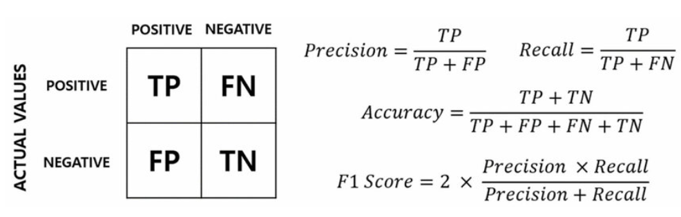
EVALUATION METRICS

Slide 37
Comparing scores
 | ACCURACY | PRECISION | RECALL | F1-SCORE
CNN | 0.9303 | 0.9308 | 0.93039 | 0.9304
VGG16 | 0.9851 | 0.9959 | 0.9756 | 0.9856
VGG19 | 0.9006 | 0.8730 | 0.9486 | 0.9092
INCEPTIONV3 | 0.9588 | 0.9816 | 0.9391 | 0.9599
RESNET50 | 0.9567 | 0.9657 | 0.9513 | 0.9584

Slide 38
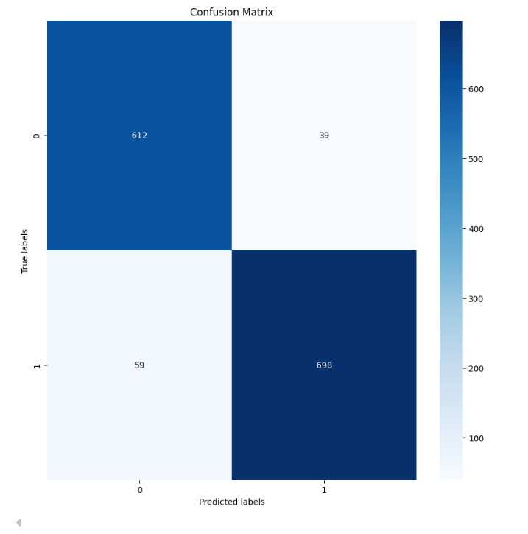
CONFUSION MATRIX

Slide 39
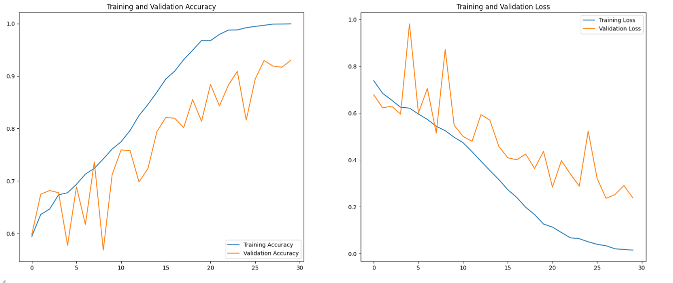
Plot Of Training And Validation Accuracy And Training And Validation Loss

Slide 40
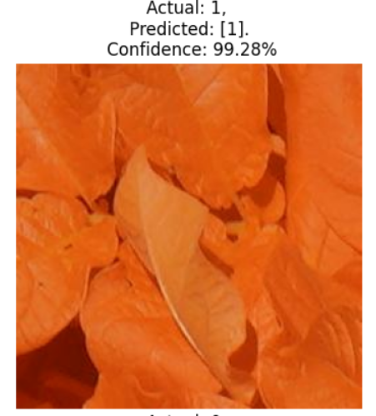
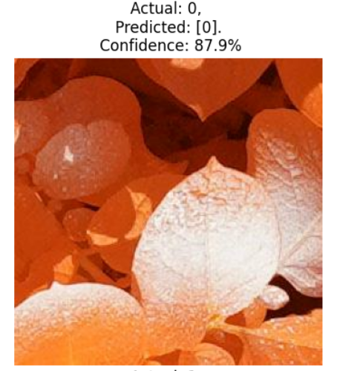

Slide 41
PRE-TRAINED MODEL EVALUATION
The reported accuracies for the various pretrained models are as follows:
VGG16: 0.9846
VGG19: 0.9040
InceptionV3: 0.9588
ResNet50: 0.9901
These accuracies indicate the percentage of correctly classified images by each model. The Resnet50 model achieved the highest accuracy.

Slide 42
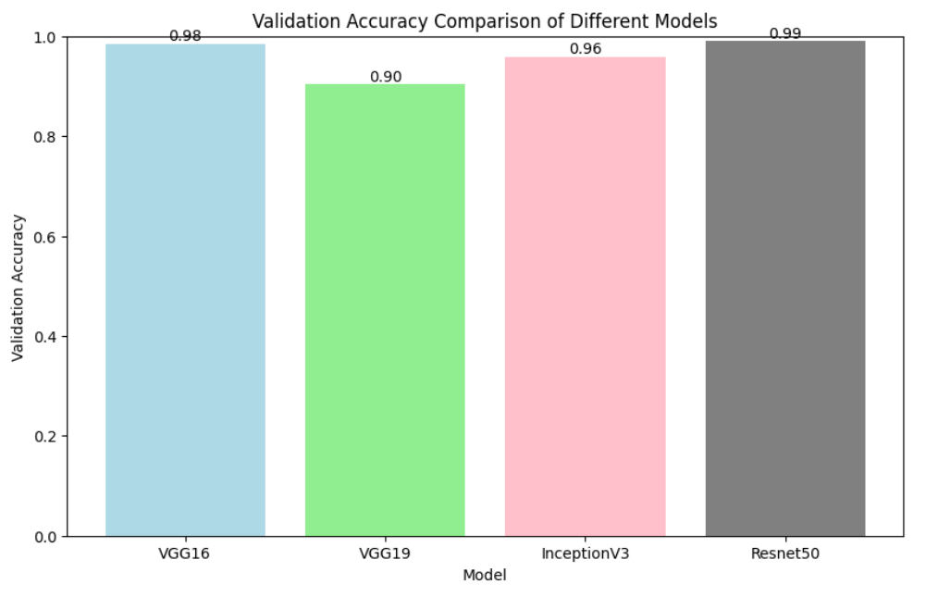
Comparing Accuracies of Pre-trained models

Slide 43
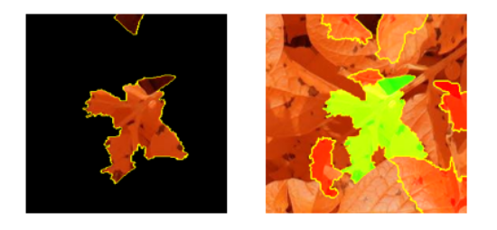
Model Predictability using LIME on Alternaria Image

Slide 44
USER INTERFACE DESIGN
It is designed using HTML, CSS, Streamlit, and Python
After uploading image, the interface itself will process it through the deep learning model and give a prediction
The UI uses Explainable AI techniques through LIME and visually elaborates on the model's decision-making process.

Slide 45
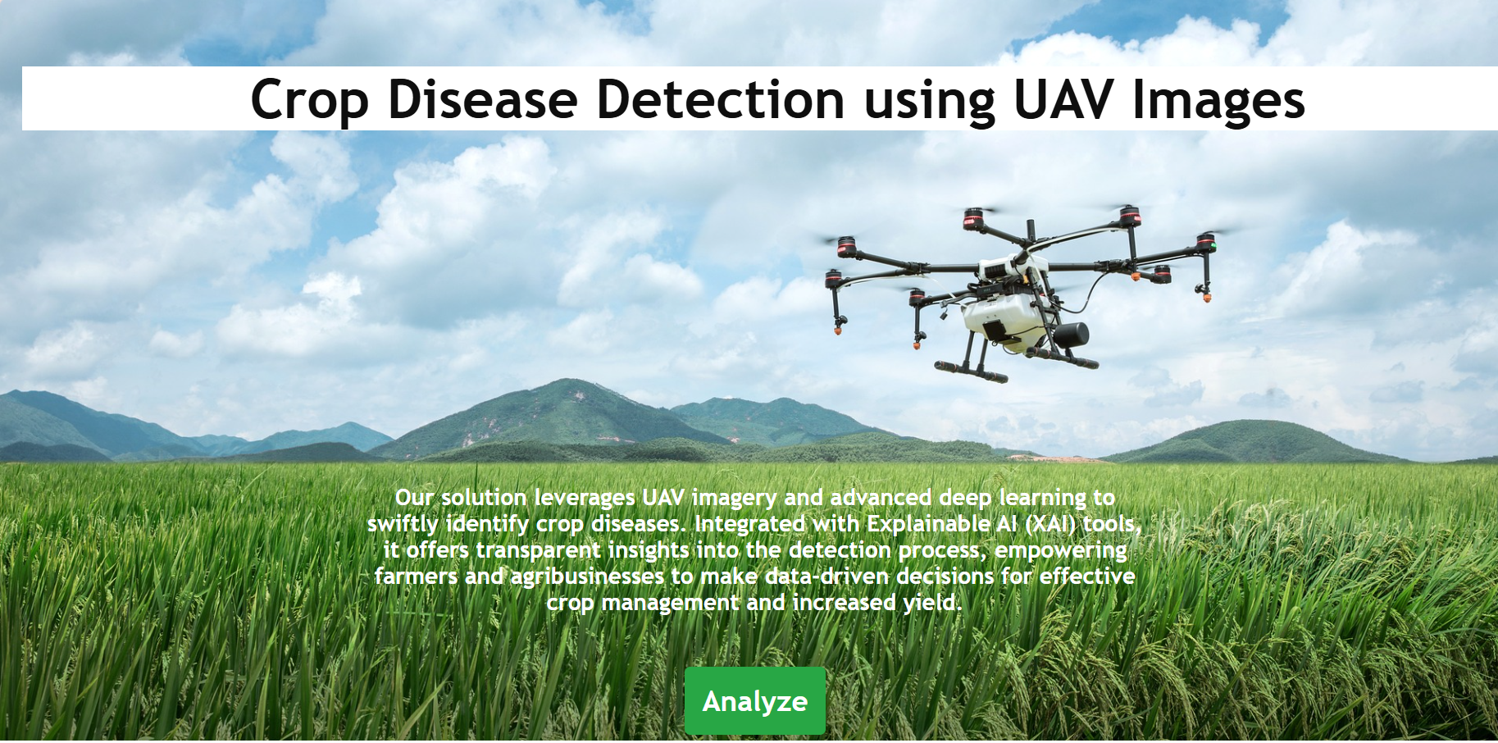

Slide 46
CONCLUSION
This Alternaria detection work using CNN and other pre-trained models has been quite successful.
Through the application of "Image Processing and deep learning Techniques", we managed to use field-based data from UAV photos to come up with a robust Alternaria detection system in potato crops.
The results proved a accuracy of 98% classification on VGG16 in distinguishing between diseased and non-diseased leaves.
The research shows not only the potential for the early detection of Alternaria from potato fields but also identifies the parameters that contribute to the prediction using Explainable Ai.

Slide 47
FUTURE WORK
Expand to More UAV Datasets
Mapping Diseased Areas Using Ground Control Points(locate Hotspots)
Integration with Real-Time UAV Systems( Live Detection)
Deploy as a Mobile Application

Slide 48
REFERENCES
Chin, R., Catal, C., & Kassahun, A. (2023). Plant disease detection using drones in precision agriculture. Precision Agriculture, 24(5), 1663–1682. https://doi.org/10.1007/s11119-023-10014-y
Chowdhury, M. E. H., Rahman, T., Khandakar, A., Ayari, M. A., Khan, A. U., Khan, M. S., Al-Emadi, N., Reaz, M. B. I., Islam, M. T., & Ali, S. H. M. (2021). Automatic and Reliable Leaf Disease Detection Using Deep Learning Techniques. AgriEngineering, 3(2), 294–312. https://doi.org/10.3390/agriengineering3020020
Shahi, T. B., Xu, C.-Y., Neupane, A., & Guo, W. (2023). Recent Advances in Crop Disease Detection Using UAV and Deep Learning Techniques. Remote Sensing, 15(9), 2450. https://doi.org/10.3390/rs15092450
Vardhan, J., & Swetha, K. S. (2023). Detection of healthy and diseased crops in drone captured images using Deep Learning (arXiv:2305.13490). arXiv. http://arxiv.org/abs/2305.13490
Vélez, S., Ariza-Sentís, M., & Valente, J. (2023). Mapping the spatial variability of Botrytis bunch rot risk in vineyards using UAV multispectral imagery. European Journal of Agronomy, 142, 126691. https://doi.org/10.1016/j.eja.2022.126691

Slide 49
Thank you
Siddhi jadhav
23070243047@sig.ac.in

